Slide 1
Data Coach | Steel Data Challenge 4 - Financial Analysis
In my capacity as a Finance Analyst at 'The Big Bank', I am embarking on a comprehensive analysis of our customers' banking behaviors. My objective is to meticulously scrutinize the diverse range of accounts they hold and the specific types of transactions they engage in. This deep dive into our banking data is aimed at developing a profound understanding of our customer base, which will be pivotal in enhancing our financial services and tailoring them to meet the evolving needs of our clients. Presented by : Sunil Kumar Pal

Slide 2
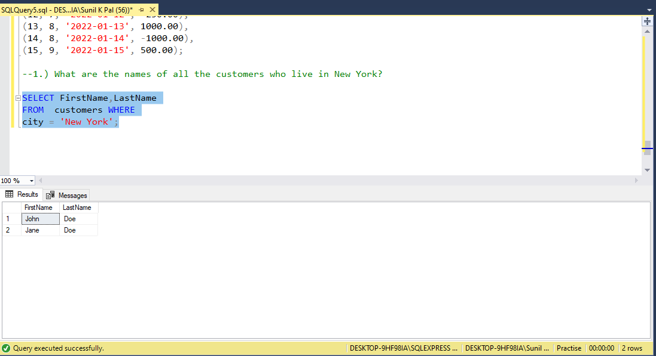
What are the names of all the customers who live in New York?

Slide 3
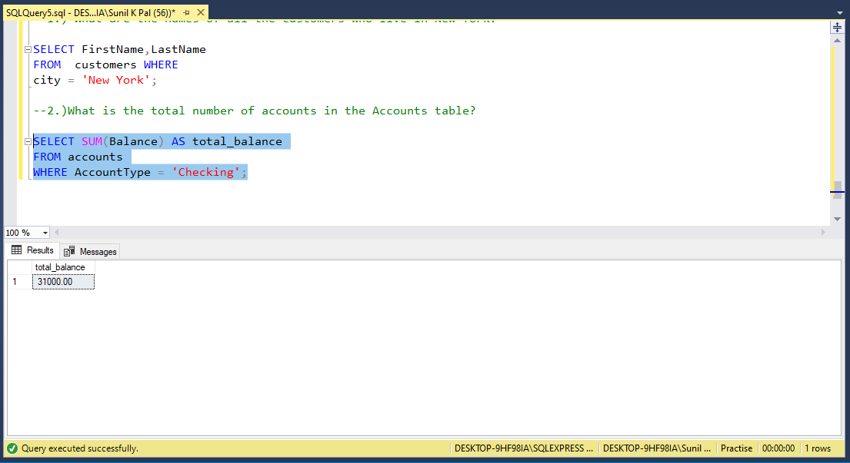
What is the total number of accounts in the Accounts table?

Slide 4
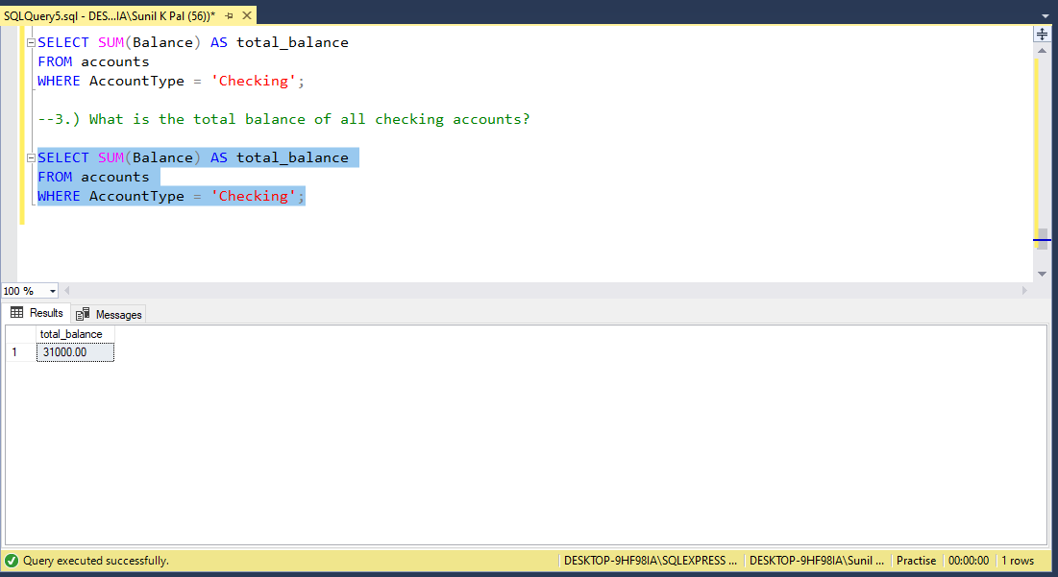
What is the total balance of all checking accounts?

Slide 5
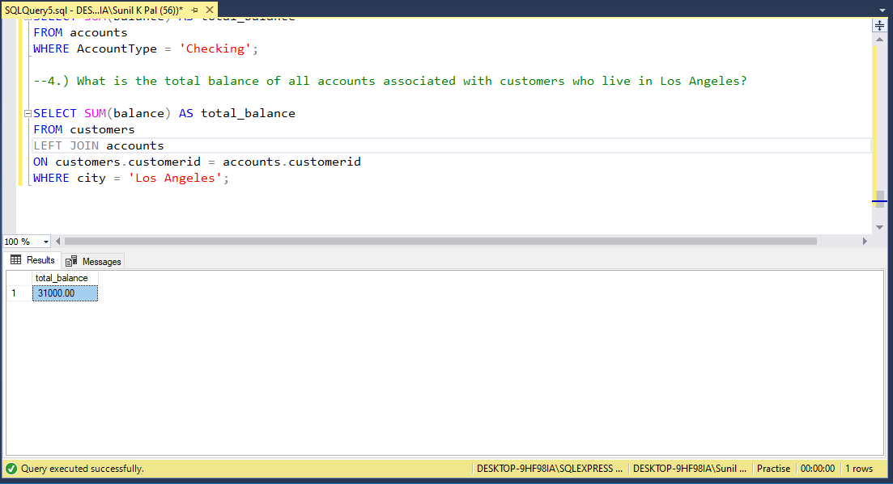
What is the total balance of all accounts associated with customers who live in Los Angeles?

Slide 6
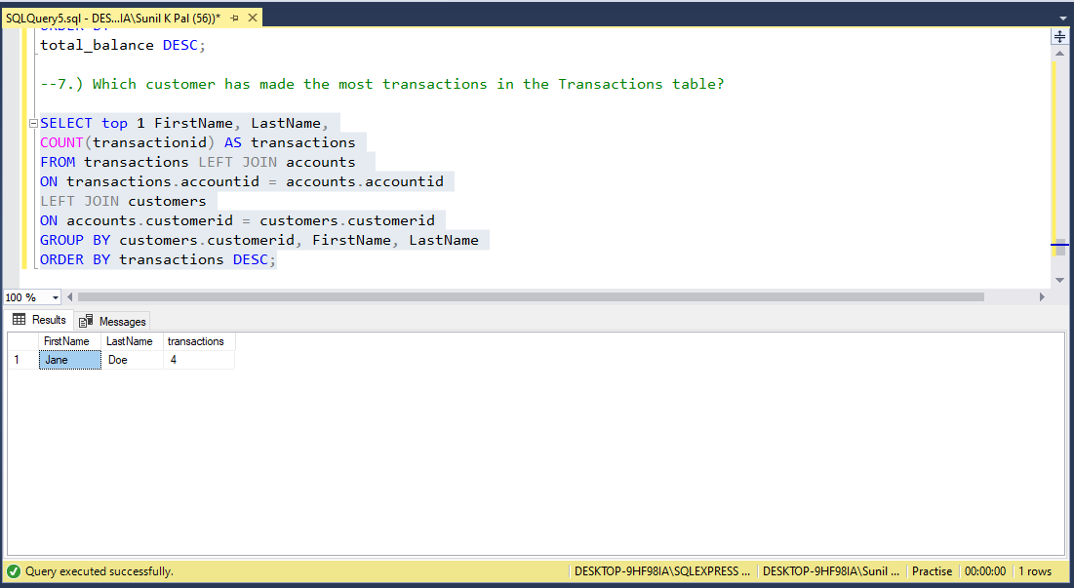
Which customer has made the most transactions in the Transactions table?

Slide 7
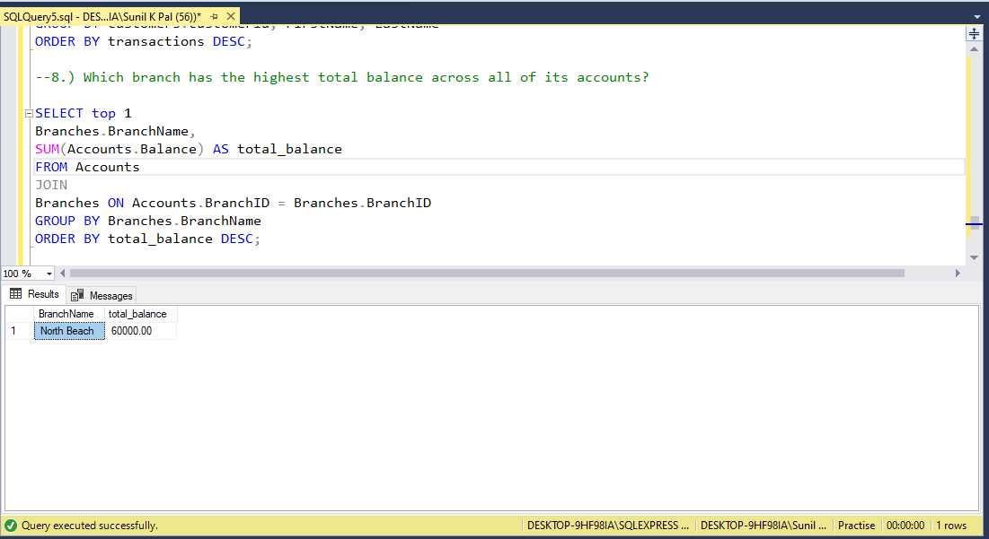
Which branch has the highest total balance across all of its accounts?

Slide 8
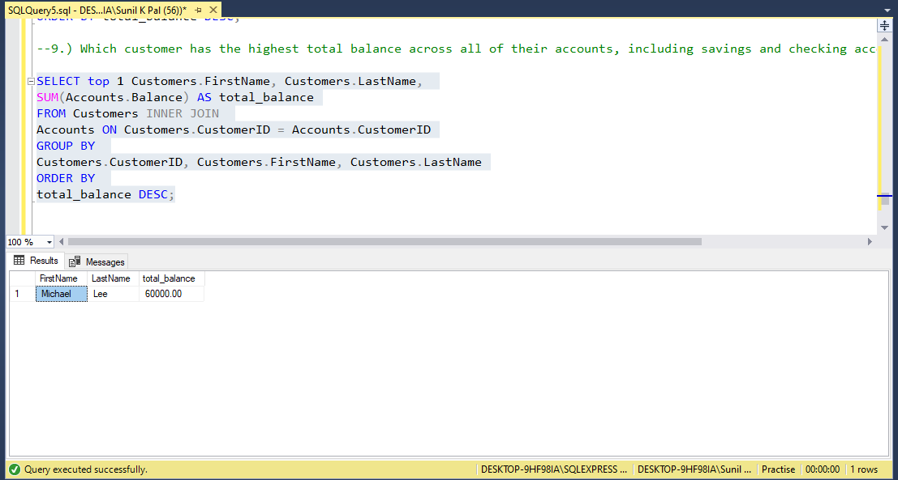
Which customer has the highest total balance across all of their accounts, including savings and checking accounts?

Slide 9
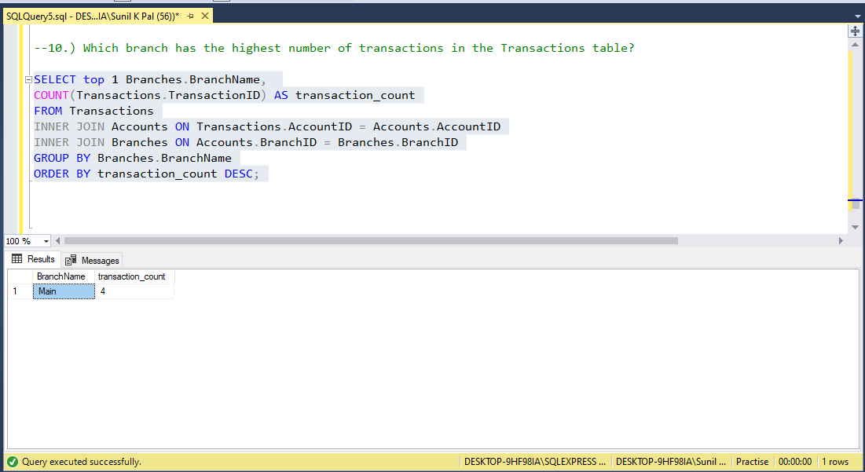
Which branch has the highest number of transactions in the Transactions table?

